Slide 1
Interactive maps with leaflet
Chris Gettings
Senior Data Scientist, BESP

Slide 2

Everything is on GitHub
This presentation:
nychealth (org members): github.com/nychealth/talkR-leaflet-cgettings
personal (public): github.com/cgettings/talkR-leaflet-cgettings
GitHub pages (rendered HTML): cgettings.github.io/talkR-leaflet-cgettings
Original project: github.com/cgettings/Light-Pollution-Map
R-server-GitHub-test:
Instructions for setting up access to nychealth GitHub org from Rstudio Server:
github.com/nychealth/R-server-GitHub-test

Slide 3

Intro to Leaflet
https://leafletjs.com/
“an open-source JavaScript library for mobile-friendly interactive maps”
leaflet R package: “An R Interface to Leaflet Maps”
https://rstudio.github.io/leaflet/
“Bindings” – R code calls custom JavaScript code, which uses Leaflet library functions

Slide 4

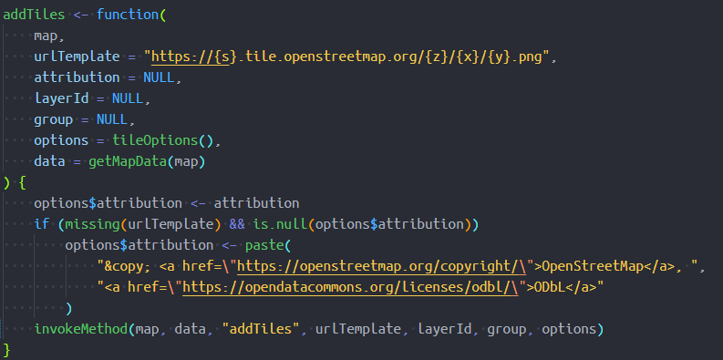

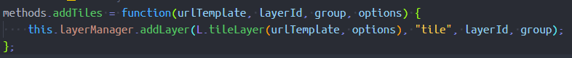
Intro to Leaflet
addTiles()
source
addTiles()
source

Slide 5
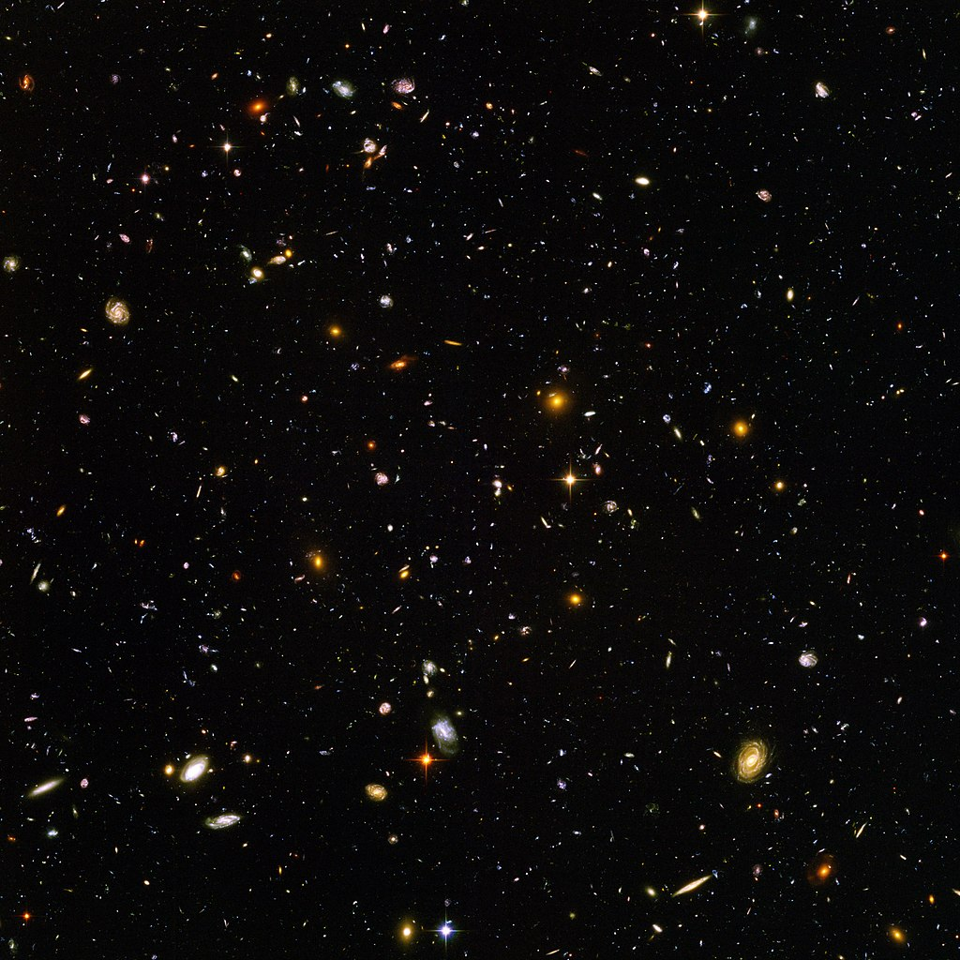

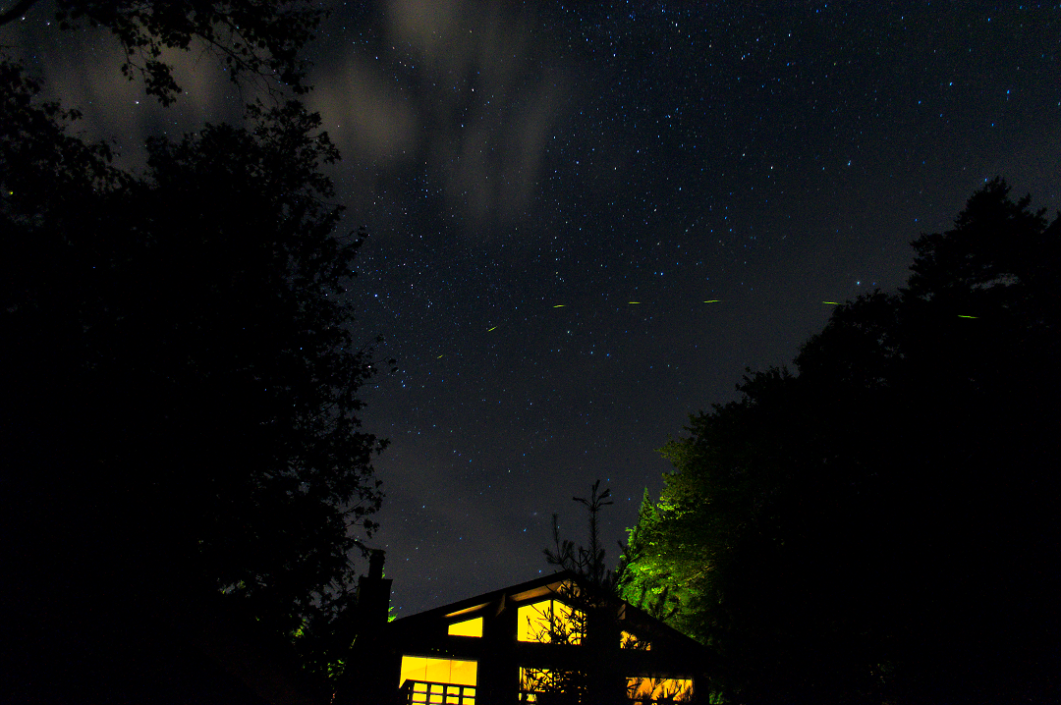
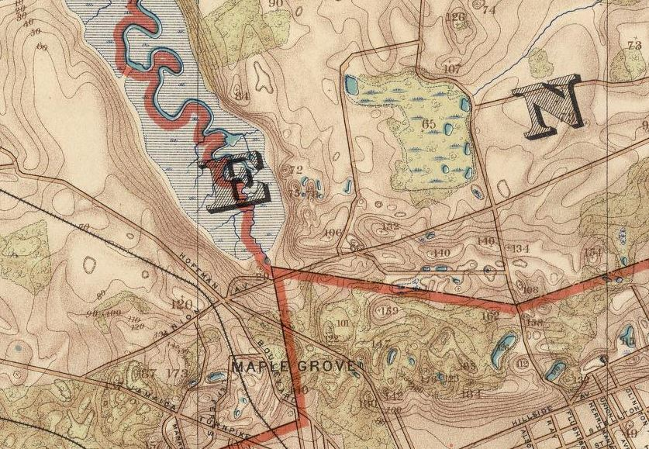
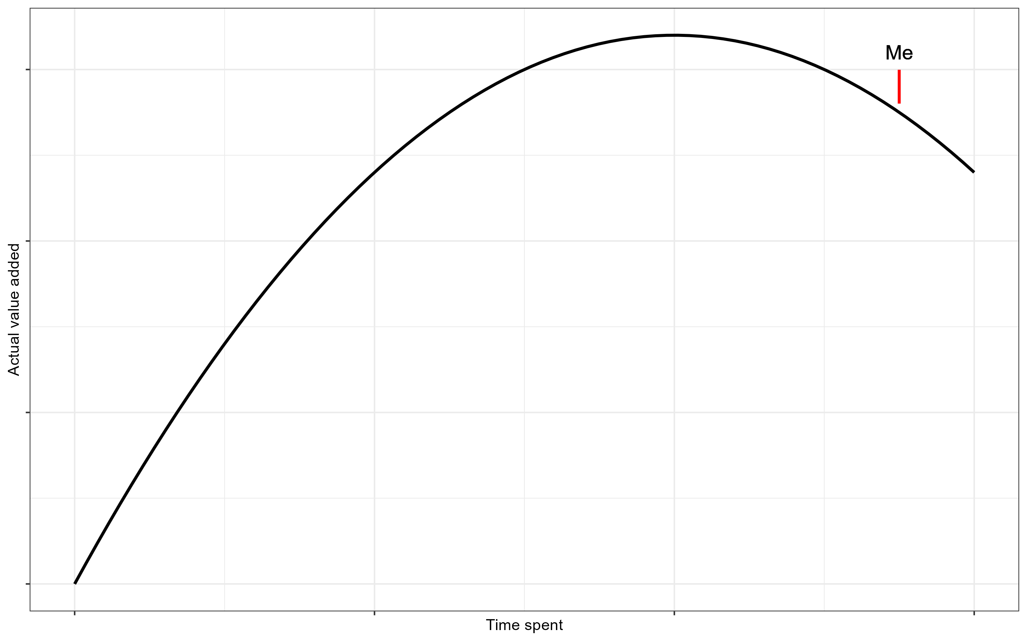
Background
I ❤️…
Notes:
Hubble Ultra Deep Field
Little Island
White Lake, NY
Source of Flushing Creek
My typical utility curve

Slide 6
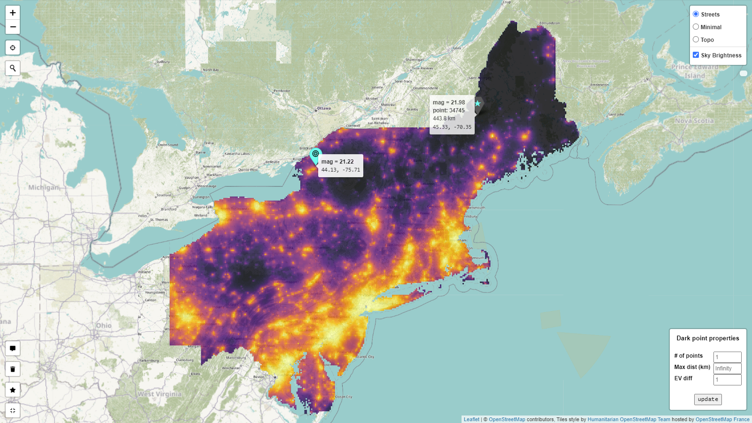
github.com/cgettings/Light-Pollution-Map

Slide 7
Examples

Slide 8
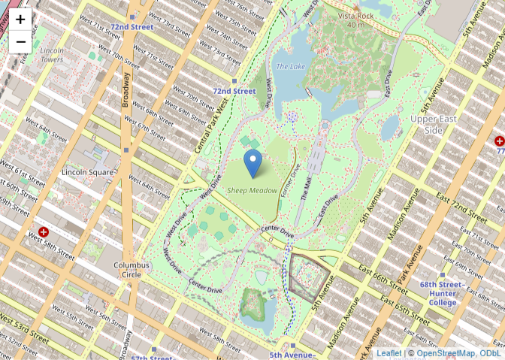
1. Basic
code/1-basic.Rmd
March 2024

Slide 9
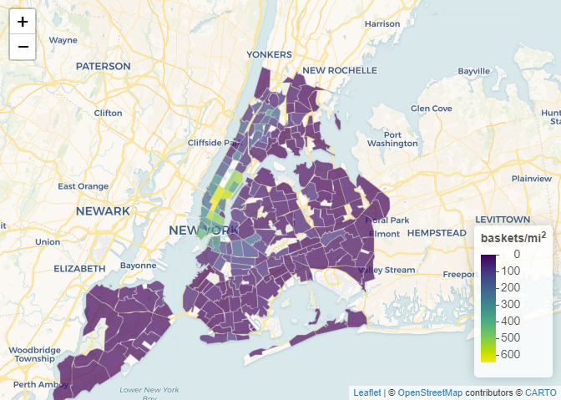
2. Choropleth - Intermediate
code/2-choropleth.Rmd
March 2024

Slide 10
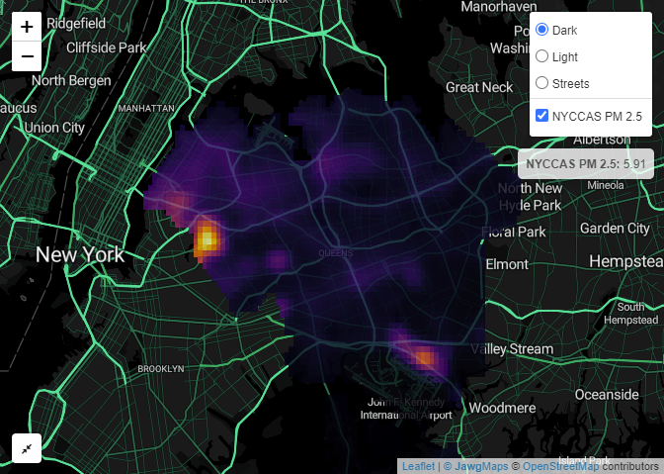
3. Raster - Advanced
code/3-raster.Rmd

Slide 11
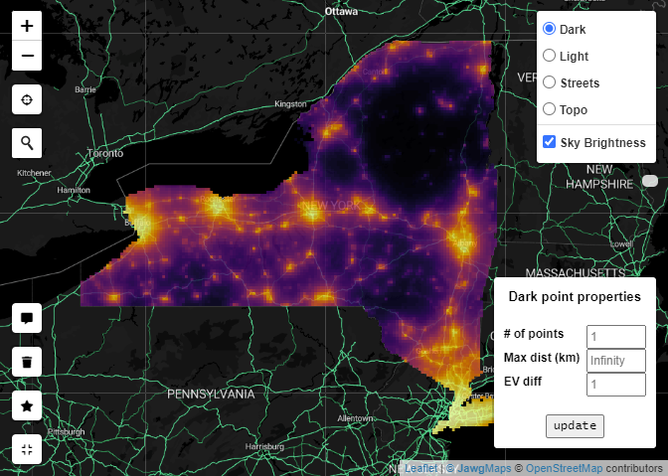
4. Light pollution - Very complicated
code/4-light_pollution.Rmd

